Slide 1

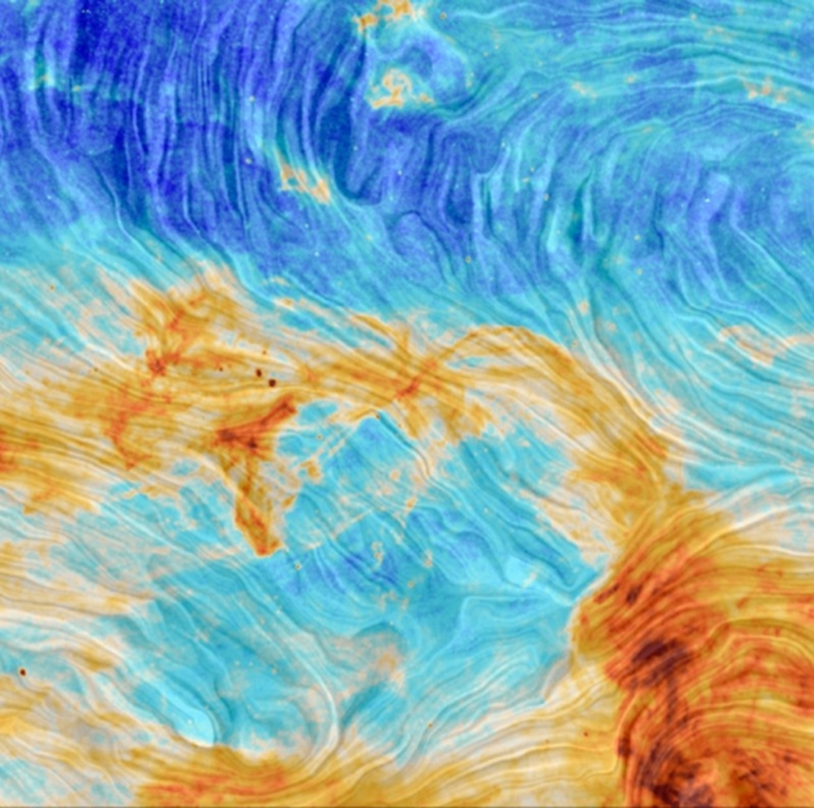
Spectral Analysis of the SPIDER region using ROHSA
Mukesh Taank (mtaank)
Supervisors: Peter G. Martin and Antoine Marchal
July 9, 2020

Slide 2
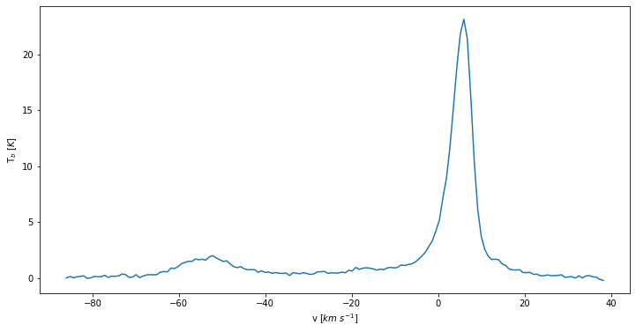
Looking along a single line of sight
Observation along the 21 cm line for one line of sight
Along one line of sight, we can extract a single spectrum to represent the emission of gas from out Milky Way Galaxy (MWG).
In this spectrum (left), there are interesting features at around 0 km/s and -50 km/s. These can be modeled using Gaussians.
We observe both warm and cold gases in the spectrum.
Narrow features indicate cold gas
Broader wings indicate warm gas
Spectrum along one line of sight on the Spider from the data cube.

Slide 3
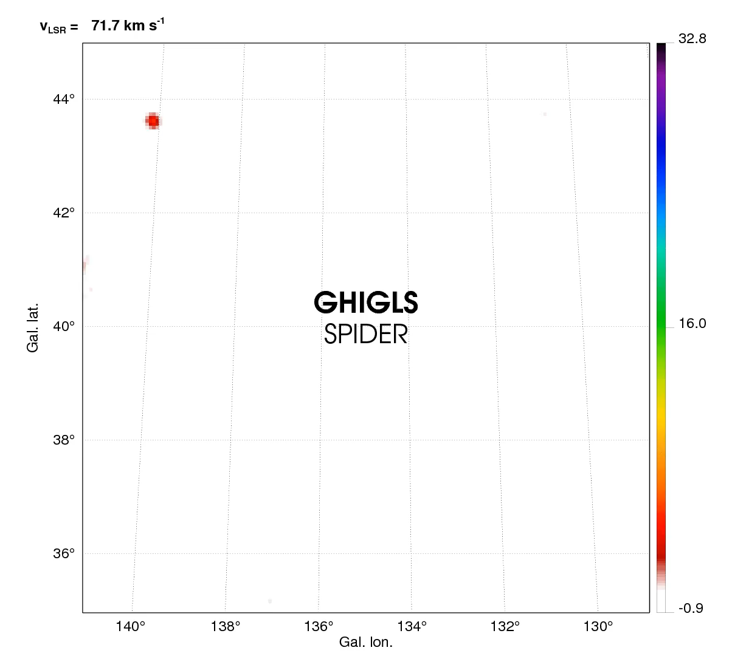
Visualizing the Data Cube
I am using the GHIGLS HI spectral data from the Green Bank Telescope.
The data are stored in a PPV data cube (Position-Position-Velocity).
The video shows spatial distribution of the brightness temperature [K] at each velocity channel.
The features seen are interstellar structures of Hydrogen (HI).

Slide 4
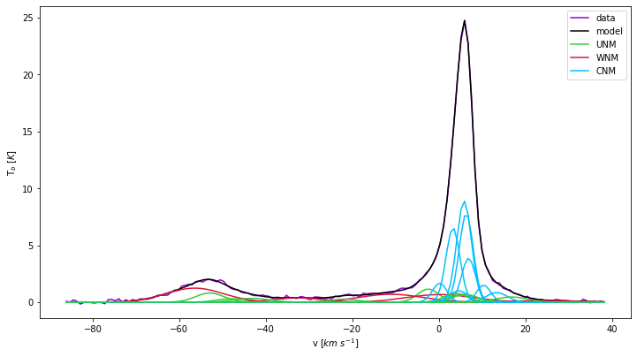
ROHSA (Regularized Optimization for Hyper-Spectral Analysis)
We are analyzing Doppler shifts and broadening, looking at the Gaussian features in the data with ROHSA.
ROHSA is a code for decomposing the data seen in the movie, with Gaussian functions.
ROHSA uses hyper parameters which control the smoothness of the solution.
Data
Model
CNM
UNM
WNM
Same spectrum on the Spider, showing the Gaussian decomposition with ROHSA. Colours encode ranges of velocity dispersion.
https://www.youtube.com/watch?v=wzhnF66ZomE

Slide 5
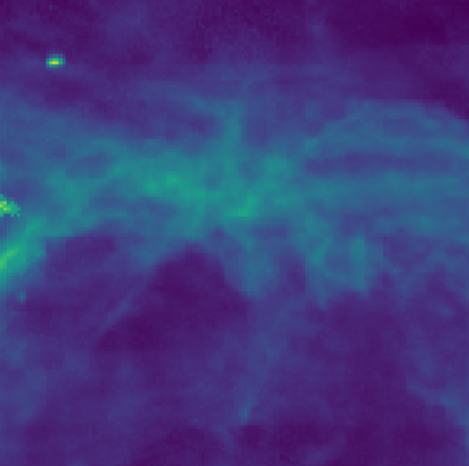

Generating a map of Column Density
For HI, column density is the integral of the brightness temperature over the velocity range:
$N_{HI}=C\int{T_{b}(v) dv}$[cm⁻²]
We compute this at every spatial pixel of the data cube to generate a map.
Such maps of the spatial features provide one important quantitative element of the analysis.
The point source in the upper left is a distant spiral galaxy (IC 2574), not of interest in our analysis of the foreground gas in the MW.
Column Density Map of the Spider

Slide 6
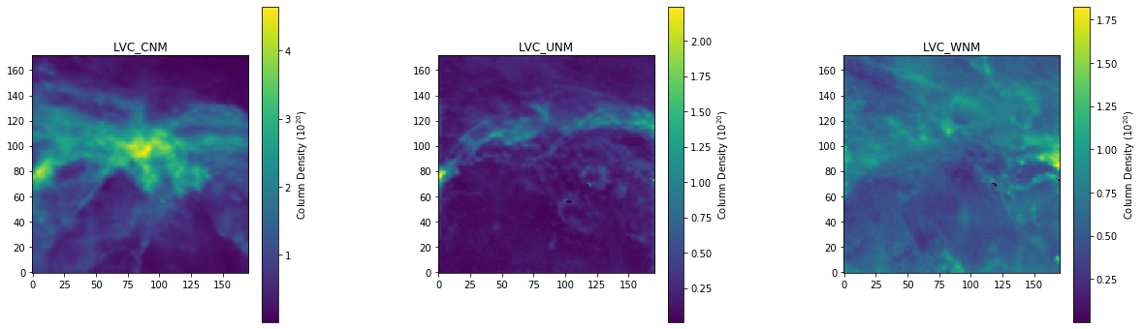
Looking at the Gas
From ROHSA’s decomposition, I am able to sort the Gaussians by their velocity dispersion, to identify cold and warm regions, which gives a 3-phase model of the Spider.
Units for these figures: HI Column Density (10²⁰ cm⁻²)
Column Density Maps of the 3-phase models of the Spider (cold, unstable, and warm)

Slide 7
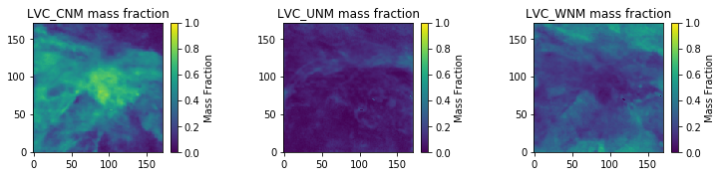
Looking at the Gas (cont.)
I can look at the mass fraction of the phases. Almost 80% of the actual Spider is made up of cold gas (CNM), whereas it contains ~10% of warm gas (WNM).
This is unusual. The gas has undergone an efficient phase transition from warm gas to cold gas in the Spider.
Maps of the mass fraction for each of the phase models along every line of sight

Slide 8
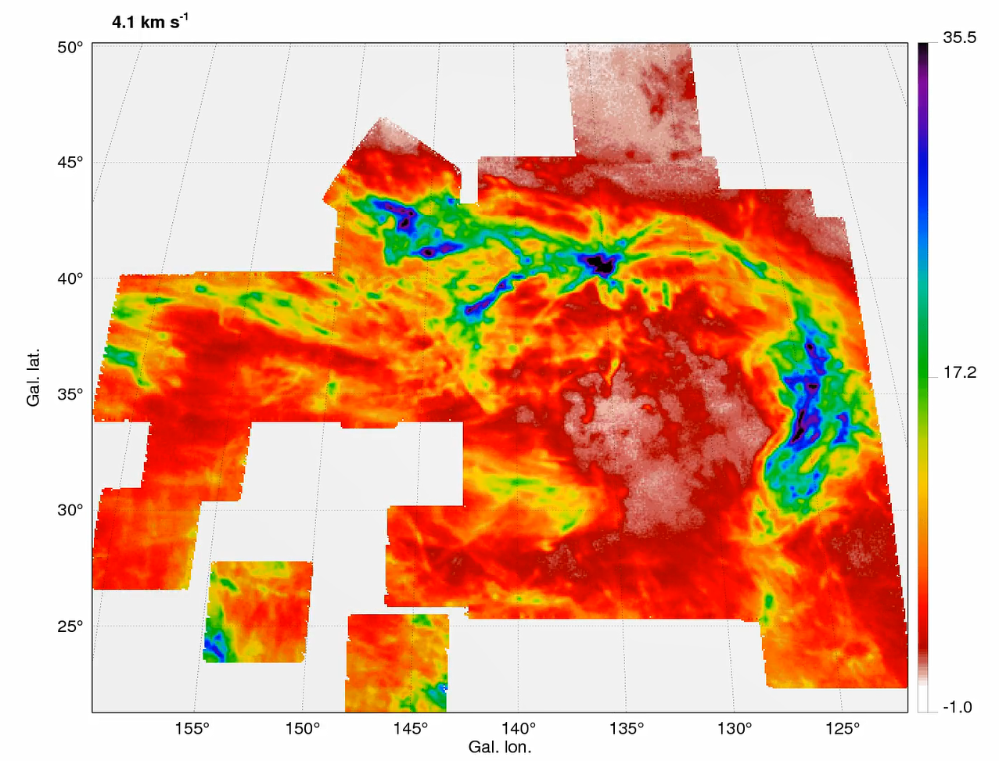
Next Steps…
So far, I have been looking at a small area of the Spider, but from the North Celestial Pole Loop (seen right), there is a lot more to the Spider.
There is evidence that phase transition occurred as the result of an energetic event that pushed gas out of the disk of the Galaxy. We see the resulting bubble in projection.
NCP

Slide 9
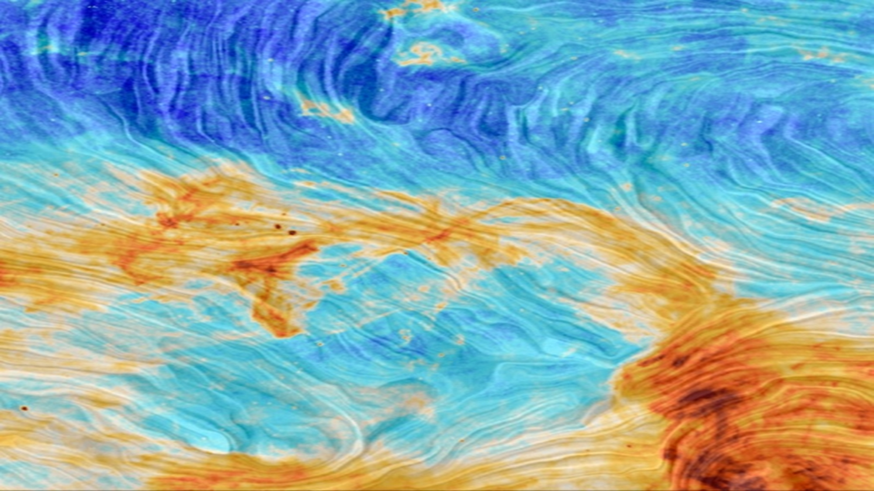
THANK YOU! Questions?

